Slide 1
Magnesium

Slide 2
Magnesium
Can be lit on fire
Atomic # is 12 (2)
Molecular weight is 24.31 g/mol (2)

Slide 3
Functions
ATP/ADP production
Magnesium helps convert ATP to ADP (10).
In plants, Mg acts as a catalyst in photosynthesis (7).

Slide 4
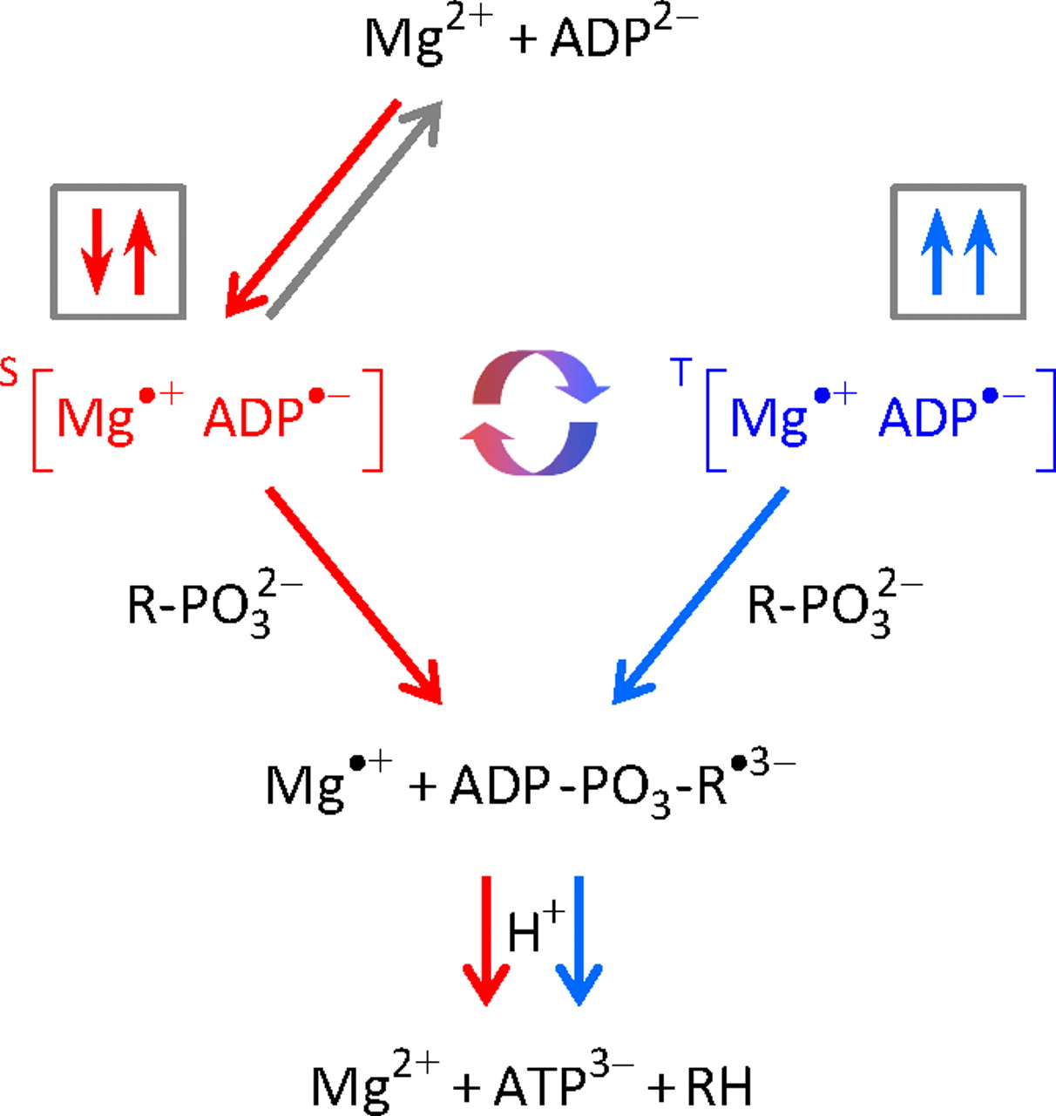
Notes:
http://www.pnas.org/content/109/5/1357/F1.large.jpg

Slide 5
Mg and Blood Pressure
If HTN and Mg deficient, HTN improves with Mg supplementation (7)
Mg alleviated angina post MI (1)
Post MI Mg supplementation improved exercise duration 14% (1)
DASH diet is naturally rich in Mg

Slide 6
Mg and BP cont.
Mg supplementation reduced BP by 12/8 mm Hg on average (365 mg/day) (3)
Mg deficiency is believed to cause vasoconstriction (11)

Slide 7
Blood sugar
Mg affects blood sugar through its role in ATP production (10)
Low Mg levels are common in diabetics (7)
Study on black women found increased Mg intake decreased the risk for type-II (11)

Slide 8
Blood sugar cont.
Mg supplementation lowers A1C in those who have hyperglycemia (10).

Slide 9
Bone Density
Magnesium deficiency is associated with low bone density (4)
Half of bodily Mg is stored in soft tissue, the other half in bones (10)
Only an ounce is stored in the body (for a 130 lb. person) (10)

Slide 10
RDA
Age | Males | Females | Pregnancy | Lactation
1-3 | 80 | 80 | N/A | N/A
4-8 | 130 | 130 | N/A | N/A
9-13 | 240 | 240 | N/A | N/A
14-18 | 410 | 360 | 400 | 360
19-30 | 400 | 310 | 350 | 310
31+ | 420 | 32 | 360 | 320

Slide 11
RDA Issues
Mg RDA is difficult to establish due to hard water (1)
Mg in hard water is 50% bioavailable (1)
Heart disease less common in areas with hard water (10)

Slide 12
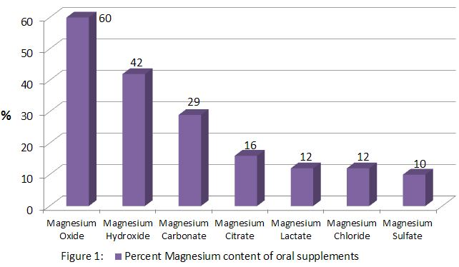
RDA Issues cont.
Notes:
Magnesium supplements differ significantly on their source

Slide 13
RDA Issues cont.
Enteric coating can decrease absorption by 50% (5).

Slide 14
Deficiency
No clear symptoms (1)
Half of population is deficient (4)
During infancy, can cause neural disorders (10)
Change in cognition (4)
Hallucinations occur in extreme cases (10)

Slide 15
Deficiency cont.
Decrease in appetite, nausea, fatigue, and weakness (10)
30-60% of alcoholics are deficient (7)
90% of alcoholics that are withdrawing and have hallucinations are deficient (7)
Muscle spasms (10)

Slide 16
Deficiency cont.
Diuretics and long term antibiotic use (10)
Absorption issues
Chron’s (5)
Gastric bypass (5)

Slide 17
Sources
Grains (7)
Mg is in bran (7)
Wheat bran is best source (7)
Chlorophyll (7)
Spinach (7)
Nuts (7)
Almonds (7)

Slide 18
References
Bender DA. Introduction to nutrition and metabolism. 4th ed. Boca Raton: CRC Press; 2008.
Campbell MK, Farrell S. Biochemistry. 7th ed. Belmont: Cengage Learning; 2012.
Dyckner T, Wester PO. Effect of magnesium on blood pressure. B Med Journal. 1983 Jun; 286: 1847-49.
Elin RJ. Magnesium metabolism in health and disease. Dis Mon. 1988 Apr;34(4): 161-218.
Fine KD, Santa Ana CA, Porter JL, Fordtran JS. Intestinal absorption of magnesium from food and supplements. J Clin Invest. 1991 Aug; 88:396-402.
Ford ES, Mokdad AH. Dietary magnesium intake in a national sample of U.S. adults. J Nutr. 2003 Sep; 133(9):2879-82.
Magnesium [Internet]. Rockville: National Institutes of Health; Unkown [Cited 2009 July 13]. Available from: http://ods.od.nih.gov/factsheets/Magnesium-HealthProfessional/
Mildvan AS. Role of magnesium and other divalent cations in ATP-utilizing enzymes. Journal. 1987;6(1):28-33.
Tucker KL, Hannan MT, Chen H, Cupples LA, Wilson PW, Kiel DP. Potassium, magnesium, and fruit and vegetable intakes are associated with greater bone mineral density in elderly men and women. Am J Clin Nutr. 1999 Apr;69(4):727-36.
Whitney E, Rolfes SR. Understanding nutrition. 11th ed. Boca Raton: CRC Press; 2010.
Van Dam RM, Hu FB, Rosenberg L, Krishnan S, Palmer JR. Dietary calcium and magnesium, major food sources, and risk of type 2 diabetes in U.S. black women. Diabetes Care. 2006 Oct;29(10):2238-43

