Slide 1
By: Laura Sheets & CHRIS ROMIto
OMG GMOs

Slide 2
ObjectiveS
To understand what a GMO is and what foods contain GMOs
To develop a better understanding between the hype and truth of GMOs
To understand how GMOs impact us and our future

Slide 3
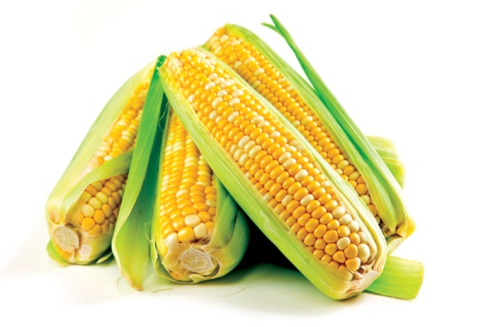
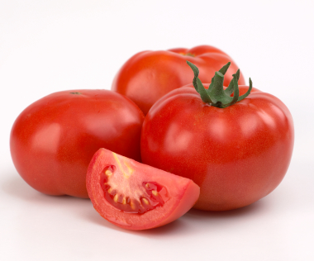
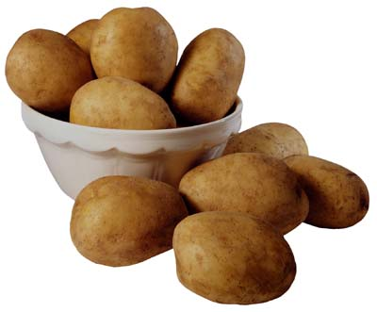
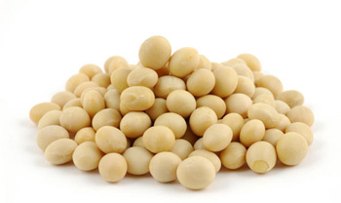
Who eats these foods on a weekly basis?
Corn
Tomatoes
Potatoes
Soy
Dairy
Notes:
https://www.google.com/search?q=corn&client=firefox-a&hs=l44&rls=org.mozilla:en-US:official&channel=fflb&source=lnms&tbm=isch&sa=X&ei=cndkUqWmN7Sz4AP0-YHADw&ved=0CAcQ_AUoAQ&biw=1366&bih=675&dpr=1#facrc=_&imgdii=_&imgrc=gj5MZb_3HNtsdM%3A%3BecfdRT6cvrIlrM%3Bhttp%253A%252F%252Fwww.acreagelife.com%252Fsites%252Facreagelife.com%252Ffiles%252FSweetCorn01.jpg%3Bhttp%253A%252F%252Fwww.acreagelife.com%252Frural-living-articles%252Fhow-sweet-sweet-corn%3B1500%3B996
https://www.google.com/search?q=tomatoes&client=firefox-a&hs=JQk&rls=org.mozilla:en-US:official&channel=fflb&source=lnms&tbm=isch&sa=X&ei=p3dkUqL_DJfk4AOgr4GYDA&ved=0CAkQ_AUoAQ&biw=1366&bih=675&dpr=1#facrc=_&imgdii=_&imgrc=ND4uftPL8ec5bM%3A%3B6uJJSbPLCGIZAM%3Bhttp%253A%252F%252Fwww.choicelunch.com%252Fassets%252FTomatoesonvine2.jpg%3Bhttp%253A%252F%252Fwww.choicelunch.com%252Four-food%252Fcold-tomatoes%252F%3B380%3B316
https://www.google.com/search?q=potatoes&client=firefox-a&hs=nlP&rls=org.mozilla:en-US:official&channel=fflb&source=lnms&tbm=isch&sa=X&ei=2HdkUvH3CLTD4APdq4G4CA&ved=0CAkQ_AUoAQ&biw=1366&bih=675&dpr=1#facrc=_&imgdii=_&imgrc=ux-F48PTyvg21M%3A%3Bbo9borb4XJveTM%3Bhttp%253A%252F%252Fstatic.ddmcdn.com%252Fgif%252Fpotatoes-1.jpg%3Bhttp%253A%252F%252Fhome.howstuffworks.com%252Fpotatoes.htm%3B400%3B331
https://www.google.com/search?q=soy&client=firefox-a&hs=DSk&rls=org.mozilla:en-US:official&channel=fflb&source=lnms&tbm=isch&sa=X&ei=HXhkUvLzB4394AOQ94HgBQ&ved=0CAkQ_AUoAQ&biw=1366&bih=675&dpr=1#facrc=_&imgdii=_b7NQB-MrtKAoM%3A%3BxMoz6zK8jItIFM%3B_b7NQB-MrtKAoM%3A&imgrc=_b7NQB-MrtKAoM%3A%3BqwTRva_tQiiWfM%3Bhttp%253A%252F%252Fus.123rf.com%252F400wm%252F400%252F400%252Fsai0112%252Fsai01121107%252Fsai0112110700229%252F10191735-soy-bean-isolated-on-white.jpg%3Bhttp%253A%252F%252Fwww.123rf.com%252Fphoto_10191735_soy-bean-isolated-on-white.html%3B1200%3B849

Slide 4
What is a gmo?
https://www.youtube.com/watch?v=uDMvucHw0qM

Slide 5
What are gmos?
An organism whose genetic material has been altered using genetic engineering techniques
A given DNA strand responsible for the given characteristic to be altered is removed
A virus containing the preferred gene attacks the host cell

Slide 6
Notes:
http://www.biologycorner.com/resources/restriction_enzyme_01.png
As you can see, an enzyme comes in and removes the genes that we don’t want in the organism anymore, meanwhile we have foreign DNA that will come in and code for new characteristics. An example of this, to make it less scientific jargon; is if you made an enzyme stop working, one that broke down cell walls to make your tomatoes soft, you could keep your tomatoes firm for longer. So you find a plant that has a similar enzyme that works at a much slower rate, take the DNA for that enzyme, and place it in your tomato DNA.

Slide 7
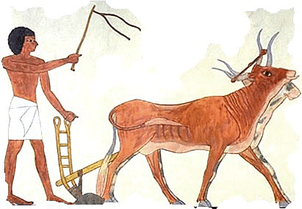
What are gmos? continued
Have been mixing genes through forced pollination for over 10,000 years(7)
Virtually everything we eat now has been altered in some way genetically(7)
Notes:
https://www.google.com/search?q=ancient+crops&client=firefox-a&hs=iA5&rls=org.mozilla:en-US:official&channel=fflb&source=lnms&tbm=isch&sa=X&ei=43hkUrTGC63G4AOfioDoBQ&ved=0CAkQ_AUoAQ&biw=1366&bih=675&dpr=1#facrc=_&imgdii=_&imgrc=XOyS1_AhMx4MBM%3A%3BnIpOg5RFbFsrFM%3Bhttp%253A%252F%252Fwww.egyptianagriculture.com%252Fimages%252Fegypt_animals.gif%3Bhttp%253A%252F%252Fwww.egyptianagriculture.com%252Fhorticulture.html%3B417%3B288

Slide 8
History
Humans have been cross-breeding and hybridizing for thousands of years (7)
1983-First approved GMO released
FLVR SVR Tomato (10)
Didn’t contain the gene that produces the enzyme that breaks down pectin
Cell walls remained strong, maintaining ripeness
Notes:
Native Americans grew multiple types of corn, purposefully making them pollinate one another to achieve a sweeter product or even one that produced more corn.

Slide 9
How? (11)
Viral method
E. Coli virus infected with a positive characteristic (derived from other organism)
Grown in petri dish with perfect environment
Seeds are then extracted

Slide 10
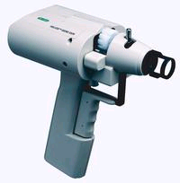
How cont. (11)
Soil method
Bacteria infects soil, infecting crop
“Gene gun”
Shoots gold particles with modified DNA into host cells
Corn and rice

Slide 11
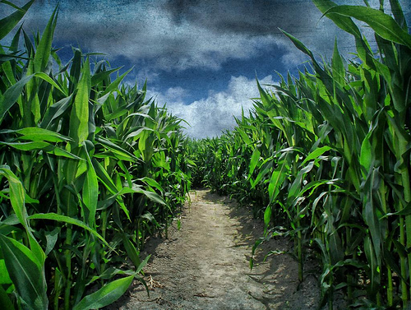
Why?
The prospect of feeding the hungry and having a reduced effect on the environment
Minimize losses from pests and diseases
Better survival in extreme environments
Potentially increase nutrient value of crops
Notes:
https://www.google.com/search?q=ancient+crops&client=firefox-a&hs=iA5&rls=org.mozilla:en-US:official&channel=fflb&source=lnms&tbm=isch&sa=X&ei=43hkUrTGC63G4AOfioDoBQ&ved=0CAkQ_AUoAQ&biw=1366&bih=675&dpr=1#channel=fflb&q=corn+fields+&rls=org.mozilla:en-US%3Aofficial&tbm=isch&facrc=_&imgdii=_&imgrc=dLMUu3xNei9naM%3A%3BNRbszWJLprQcJM%3Bhttp%253A%252F%252Fksusigmaalpha.files.wordpress.com%252F2013%252F04%252Fcorn-field.jpeg%3Bhttp%253A%252F%252Fksusigmaalpha.com%252Fagriculture-news%252F%3B500%3B377

Slide 12
Laws and legislature
Government focuses on product, not process
Safety testing is optional (2)
Labeling is not necessary (2)
As long as it’s substantially equivalent
In other countries, by law, they cannot grow GM crops and must label any potential GM products(7)

Slide 13
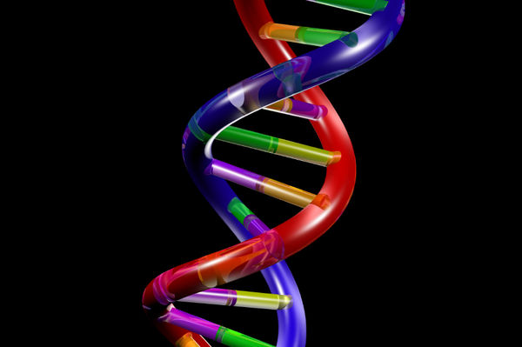
THE Hype about gmos(13)
They are unsafe and cause cancer
Unpredictable consequences
Mutant genes added to crops
Negative effects on body
Notes:
http://www.zmescience.com/tag/dna/

Slide 14
The hype continued
They are unregulated and unknown(13
No mandatory labeling(2)
No safety testing requirements(13)
Allergens and toxins(14)
nutrition losses(14)
Notes:
http://ambertick.com/opinion/danger-of-flea-control-products/

Slide 15
The hype continued
Disrupts nature and hurts the environment
No increase in yield(13)
Increases use of pesticides, herbicides and fungicides(13)
Emergence of super weeds and super bugs(14)
Long term impact unknown
Notes:
Organic authority And Non gmo project

Slide 16
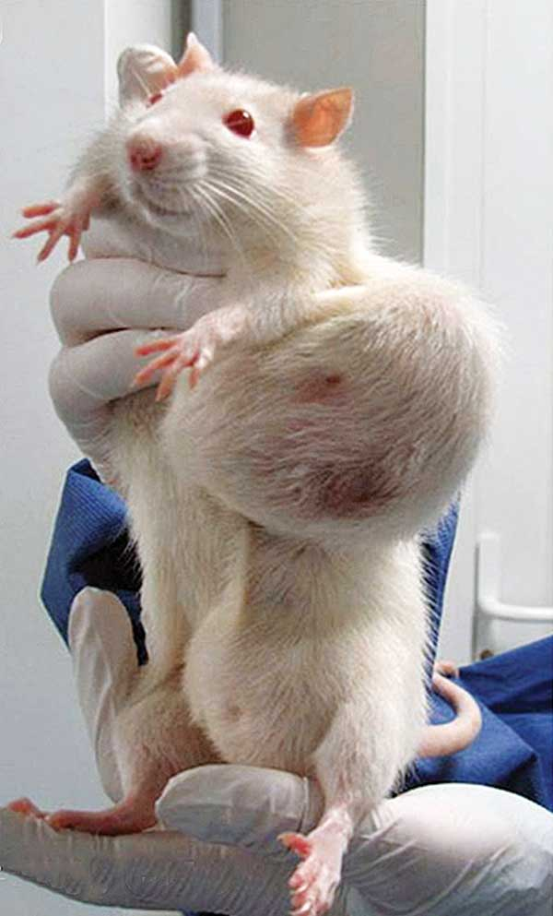
Foods genetically modified
Potatoes
Rats given normal diet, normal diet plus GM potatoes, and normal diet plus regular potatoes (4)
Pancreatic growth (4)
Small intestine and stomach hypertrophy (4)
Modification reduces pests (4)
Notes:
http://www.motherearthnews.com/natural-health/gmo-safety-zmgz13amzsto.aspx
It’s important to note that of the 21 varieties of GM corn, potatoes, and rice observed in this same meta-analysis, only a few had slight effects, with these potatoes being the only one that would affect quality of life.

Slide 17
Notes:
http://www.realfooddigest.com/wp-content/uploads/2011/01/GM-mice-livers.jpg

Slide 18
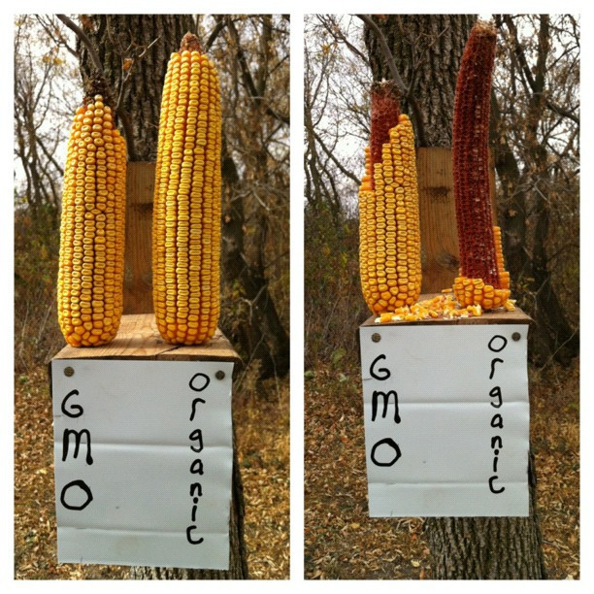
What foods are genetically modified?
Bt corn
Corn is altered to contain a bacterium that kills caterpillars (2)
The pollen is poisonous to butterflies and bees as well (2)
No effect found on sows or their offspring during pregnancy or lactation (1)

Slide 19
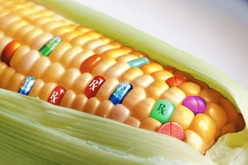
Foods genetically modified cont.
Bt corn
has some decreased nutritional value
Has 437x less calcium (14 ppm vs 6130 ppm) (5)
Has 56x less magnesium (2 ppm vs 113 ppm) (5)
Detoxifying organs (mainly kidneys and liver) damage shown after 2 years in mice (5)
The heart, adrenal glands, spleen (5)
Notes:
http://boydfuturist.wordpress.com/2013/01/06/gmos-the-future-of-food/

Slide 20
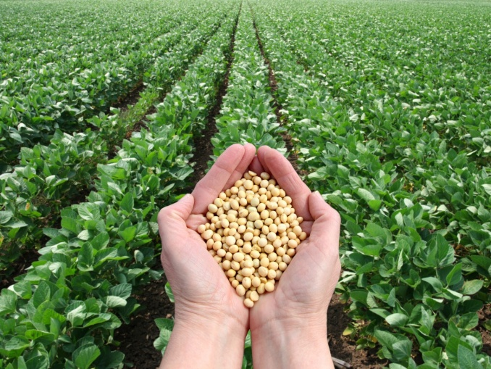
Foods genetically modified cont.
Soy beans
Modified to improve overall yield (2)
People who consumed the transgenic soy beans are more likely to develop a soy allergy (2,9)
Notes:
http://www.salon.com/2013/05/13/monsanto_wins_scotus_case_over_genetically_engineered_soy_beans_ap/

Slide 21
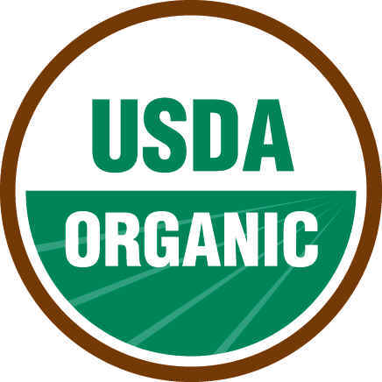
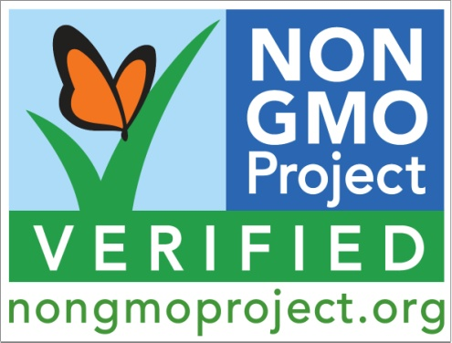
What foods don’t contain gmos(6)
100% certified organic foods
Products with the “Non-GMO Project” verified seal
Avoid or use caution with “at-risk” foods and ingredients
Corn, soybeans, canola, cottonseed, sugar beets, some dairy
Notes:
http://www.nongmoshoppingguide.com/tips-for-avoiding-gmos.html
http://www.nongmoproject.org/learn-more/understanding-our-seal/
http://www.omorganics.org/page.php?pageid=117

Slide 22
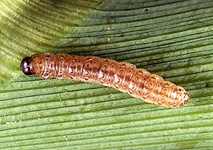
Saving farmers’ money
Saving billions for farmers(8)
Greatly reduced pest attacks
Reduces pesticide and herbicide reliance
Greater yields overall through loss savings
Notes:
http://www.ars.usda.gov/is/graphics/photos/nov97/k7834-3.htm pic

Slide 23
The facts
“Risks that are uncertain and dreaded tend to be more feared”(15)
–James Hammitt, director of the Harvard Center for Risk Analysis
GMOs are poorly understood by consumers(15)
A lot of the hype is not evidence-based(15,16)
Many organizations strongly one-sided(15)
Constantly working to monitor and regulate new GM varieties
Notes:
http://www.washingtonpost.com/lifestyle/food/genetically-modified-foods-what-is-and-isnt-true/2013/10/15/40e4fd58-3132-11e3-8627-c5d7de0a046b_story.html
http://www.forbes.com/sites/jonentine/2013/10/14/2000-reasons-why-gmos-are-safe-to-eat-and-environmentally-sustainable/

Slide 24
The Facts continued
“The organizations I found that pass, though, form a compelling coalition. The National Academies, the American Medical Association, the World Health Organization, the Royal Society and the European Commission are all on the same side. Although it’s impossible to prove anything absolutely safe, and all of those groups warn that vigilance on GMOs and health is vital, they all agree that there’s no evidence that it’s dangerous to eat genetically modified foods.”(16)
Notes:
http://www.washingtonpost.com/lifestyle/food/genetically-modified-foods-what-is-and-isnt-true/2013/10/15/40e4fd58-3132-11e3-8627-c5d7de0a046b_story_1.html

Slide 25
The Facts continued(17)
EPA evaluates GM plants for environmental safety
Conduct risk assessment studies on pesticides that could harm humans and the environment
UDSA evaluates whether the plant is safe to grow
Conduct risk assessment of the potential hazards of the plant
FDA evaluates whether the plant is safe to eat
Believes that GM foods are substantially equivalent to unmodified foods

Slide 26
The facts continued(16)
Not a single instance of harm to humans in the decades of consumption(15)
Allergy effects not clinically proven
No credible evidence against environmental effects
Pesticide use has actually decreased 10% since 1996
Better soil quality, crop protection, water and animal safety
Notes:
http://jenhaugenrd.wordpress.com/2013/11/01/whats-the-truth-about-gmo-food-biotechnology-series-part-3/

Slide 27
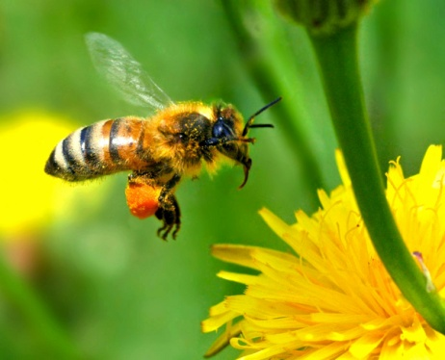
The facts continued(15)
Pesticides target only pests that damage those crops, not honey bees
Weed control is better(7,8)
Carbon footprint reduced
Less turn over needed on soil, so less driving and carbon released into the atmosphere
Equivalent to 9.4 million cars off the road
Notes:
http://consciouslifenews.com/wp-content/uploads/2013/03/honey-bee.jpg

Slide 28
The facts continued(17)
Bt corn and monarch butterflies
Consume milkweed, not corn
Fears of pollen transfer to milkweed
Study wasn’t done in natural field conditions
Data being re-examined; thought to be flawed

Slide 29
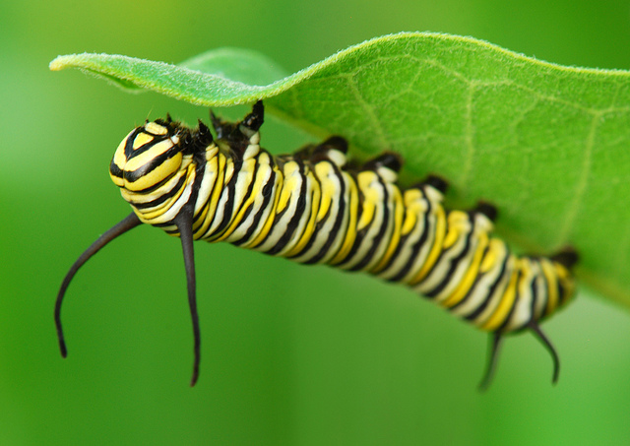
Solutions to Bt corn issue
Genes are transferred via pollen
Modify GM plants to be male sterile (no pollen)
Cross-pollination wouldn’t occur and wouldn’t be harmful to caterpillars
Modify the plant so the pollen doesn’t contain the new gene
Notes:
http://farm6.staticflickr.com/5152/5915522859_30737b759b_z.jpg

Slide 30
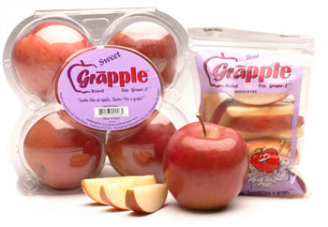
Benefits(2)
Could lead to cheaper food
Higher nutrient content
Reduced pesticide use(15)
Resistance to weeds and
pests(7,8,15)
Longer shelf life
New crops/food combinations
Notes:
https://www.google.com/search?q=ancient+crops&client=firefox-a&hs=iA5&rls=org.mozilla:en-US:official&channel=fflb&source=lnms&tbm=isch&sa=X&ei=43hkUrTGC63G4AOfioDoBQ&ved=0CAkQ_AUoAQ&biw=1366&bih=675&dpr=1#channel=fflb&q=grapple&rls=org.mozilla:en-US%3Aofficial&tbm=isch&facrc=_&imgdii=_&imgrc=6AgMguuYgmaMdM%3A%3BPx0Bl-OqlqlKiM%3Bhttp%253A%252F%252Fwww.fooducate.com%252Fblog%252Fwp-content%252Fmedia%252Fgrapple.jpg%3Bhttp%253A%252F%252Fblog.fooducate.com%252F2010%252F10%252F27%252Fgrapples-apples-that-taste-like-grapes%252F%3B350%3B242

Slide 31
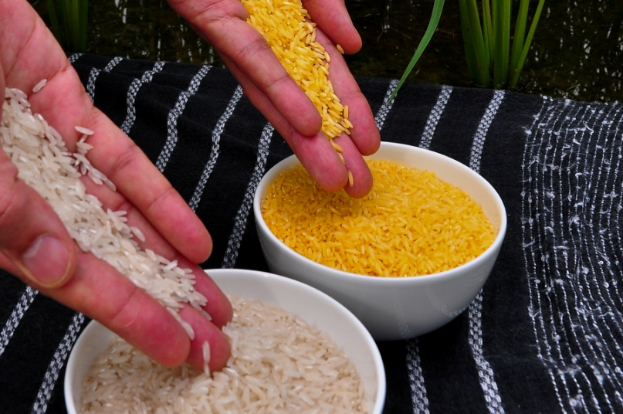
Future foods
Golden rice
Rice modified to contain vitamin A (2)
Wheat
Currently working to improve nutritional content and yield while decreasing pests (2)
Salmon
Multiple corporations are working to patent a salmon that needs less food (2)
Notes:
http://upload.wikimedia.org/wikipedia/commons/2/29/Golden_Rice.jpg

Slide 32
Conclusion:
Disadvantages:
Adverse health effects in mice
Not well regulated
Potential creation of super weeds
Will disease gain resistance?
Still information unknown about GMOs altogether
Notes:
http://www.realfoodgirlunmodified.com/gmos-for-newbies/

Slide 33
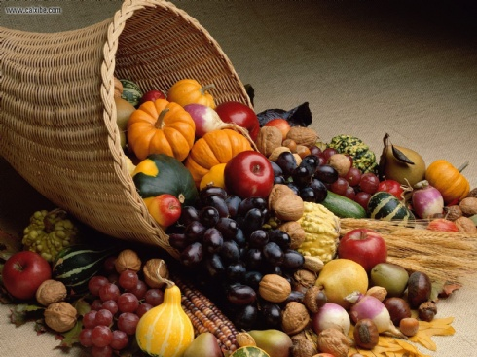
Conclusion:
Advantages:
Mice studies don’t always translate to humans
Have been modifying crops since ancient times(7)
No documented adverse health effects in humans(7)
Greater yields and financial benefits for farmers(7)
Hype isn’t evidence based
Possibly an answer to the
world hunger crisis?
Notes:
http://wallpaperweb.org/wallpaper/miscellaneous/bountiful-harvest_16919.htm

Slide 34
Conclusion
Such a huge potential for benefits
Solution to the world hunger crisis?
Many people don’t even know what they are so are we creating unnecessary hysteria?
Why are we so quick to dismiss GMOS?
Notes:
Hysteria- think back to opening video

Slide 35
Are GMOs Safe?
You Decide.

Slide 36
References
1.Effects of feeding Bt MON810 maize to sows during first gestation and lacation on maternal and offspring health indicators. Walsh MC, Buzoianu SG, Gardiner GE, Rea MC, O’Donovan O, Ross RP, Lawlor PG. Br J Nutr, 2013 Mar 14;109(5):873-81.
2.Examples of GMOs. Hudson: HudsonAlpha Institute for Biotechnology. [cited 2013 Oct 8].
3.Answers to critics: Why there is a long term toxicity due to a Roundup tolerant genetically modified maize and to a Roundup herbicide. Seralini GE, Mesnage R,Defarge N, Gress S,Hennequin D, Clair E, et al. Food and Chemical Toxicology 53 (2013) 476-483.
4. Domingo JL, Bordonaba JG. A literature review on the safety asessment of genetically modified plants. Environment International 37 (2011) 734-742.
5. GMO Versus Non-GMO- The Shocking Corn Comparison [internet]. Natural Health News and Holistic Healing; 2013. [updated may 6 2013; cited 2013 Oct 2013]. Available from: http://www.undergroundhealth.com/gmo-versus-non-gmo-the-shocking-corn-comparison/
6. Non-GMO Shopping Guide. [internet]. [updated 2010; cited 2013 Oct 8]. Available from: http://www.nongmoshoppingguide.com/
7. Ronald P. THE TRUTH ABOUT GMOs. (cover story). Boston Review [serial on the Internet]. (2013, Sep), [cited October 20, 2013]; 38(5): 16. Available from: Points of View Reference Center.
Notes:
How are GMOs Made?. http://www.qub.ac.uk/cite2write/vancouver3b.html (accessed 21 September 2013).
Benefits of GM food. http://classes.soe.ucsc.edu/cmpe080e/Spring05/projects/gmo/benefits.htm (accessed 21 September 2013).
GMO Versus NON GMO - The Shocking Corn Comparison. http://www.undergroundhealth.com/gmo-versus-non-gmo-the-shocking-corn-comparison/ (accessed 19 September 2013).
Walsh MC, Buzoianu SG, Gardiner GE, Rea MC, O'Donovan O, Ross RP, Lawlor PG. Effects of feeding Bt MON810 maize to sows during first gestation and lactation on maternal and offspring health indicators. Br J Nutr 2013; 109(5): 873-881. http://www.ncbi.nlm.nih.gov/pubmed/23168255 (accessed 18 September 2013).
Seralini GE, Mesnage R, Defarge N, Gress S, Hennequin D, Clair E, et al.. Answers to Critics: Why There is a Long Term Toxicity Due to a Roundup-Tolerant Genetically Modified Maize and to a Roundup Herbicide. Elsevier 2013; 53(): 440. http://www.sciencedirect.com/science/article/pii/S0278691512008149 (accessed 19 September 2013).
Pusztai A, Vardocz S. Potential Health Effects of Foods Derived from Genetically Modified Plants: What are the Issues?. Penang, Malaysia: Third World Network; 2011. http://www.twnside.org.sg/title2/biosafety/pdf/bio14.pdf (accessed 20 September 2013).
Domingo JL, Bordonaba JG. A Literature Review on the Safety Assessment of Genetically Modified Plants. Elsevier 2011; 37(4): 734-742. http://www.sciencedirect.com/science/article/pii/S0160412011000055 (accessed 20 September 2013).
GMO – Laws. http://classes.soe.ucsc.edu/cmpe080e/Spring05/projects/gmo/laws.htm (accessed 25 September 2013)
?

Slide 37
References cont.
8. Suszkiw J (2010) New Study Shows Benefits of Bt Corn to Farmers, Available at: http://www.ars.usda.gov/is//pr/2010/101007.htm (Accessed: 2 Oct 2013).
9. Herman EM (2003) 'Genetically Modified Soybeans and Food Allergies', J Exp Bot, 54(386), pp. 1317-1319.
10.Bruening G, Lyons J.M. The case of the FLAVR SAVR tomato. California Agriculture 54(4):6-7
11. Statement of policy-Foods derived from new plant varieties [internet]. [Place unkown]: U.S. food and drug administration; 1992 [updated 2013 Aug 15; cited 2013 Nov 3]. Available from:http://www.fda.gov/food/guidanceregulation/guidancedocumentsregulatoryinformation/biotechnology/ucm096095.htm
12. Keefer, J. Genetic modification in nature [internet]. Seattle: University of Washington. [cited 2013 Nov 3]. Available from: http://courses.washington.edu/z490/gmo/natural.html
13. Urban S. 8 Reasons GMOs are Bad for You. http://www.organicauthority.com/foodie-buzz/eight-reasons-gmos-are-bad-for-you.html (accessed 1 November 2013).
14. The Good, Bad and Ugly about GMOs. http://naturalrevolution.org/gmo-resources/the-good-bad-and-ugly-about-gmos/ (accessed 1 November 2013).
15. Haspel T. Genetically Modified Foods: What is and isn't True. http://www.washingtonpost.com/lifestyle/food/genetically-modified-foods-what-is-and-isnt-true/2013/10/15/40e4fd58-3132-11e3-8627-c5d7de0a046b_story.html (accessed 2 November 2013).
16. Haugen J. What's the Truth About GMO: Food Biotechnology Series (Part 3). http://jenhaugenrd.wordpress.com/2013/11/01/whats-the-truth-about-gmo-food-biotechnology-series-part-3/ (accessed 2 November 2013).
17. Whitman D. Genetically Modified Foods: Harmful or Helpful?. http://www.csa.com/discoveryguides/gmfood/overview.php (accessed 30 November 2013).

Slide 38
The hunger games
Are these products GMO-free or do they probably contain GMOS?

Slide 39
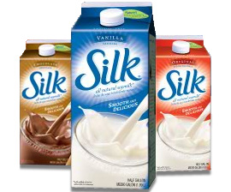
Silk Soymilk?
Notes:
http://www.savingwithshellie.com/safeway-silk-soymilk-99/

Slide 40
GMO-free

Slide 41
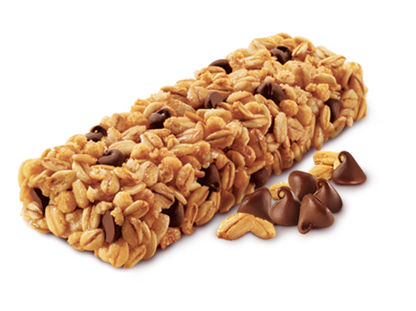
Quaker Granola bars
Notes:
http://acevending.net/popup_image.php?pID=470

Slide 42
Contains GMOs

Slide 43
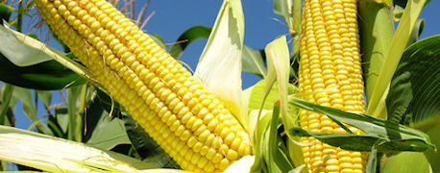
Asgrow high-yield corn
Notes:
http://farmprogress.com/cdfm/Faress1/author/198/2013/6/reaching_elusive_300_bushel_yield_corn_1_635070745478422907.jpg

Slide 44
Contains GMOs

Slide 45
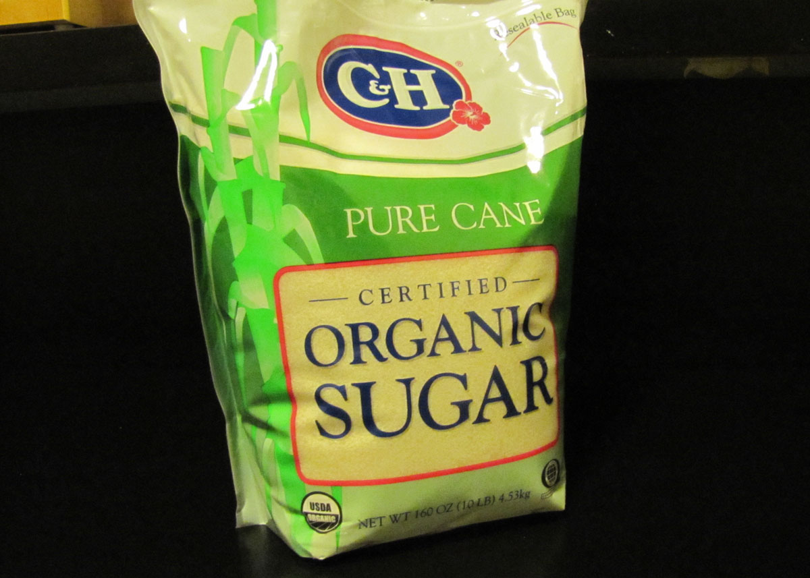
Pure cane certified organic sugar
Notes:
http://1.bp.blogspot.com/-MeLfDt4BbIY/ThvEmXn2omI/AAAAAAAAI2g/qYh7Du0zVbg/s1600/C%2526H%2BOrganic%2BPure%2BCane%2BSugar.jpg

Slide 46
GMO-free

Slide 47
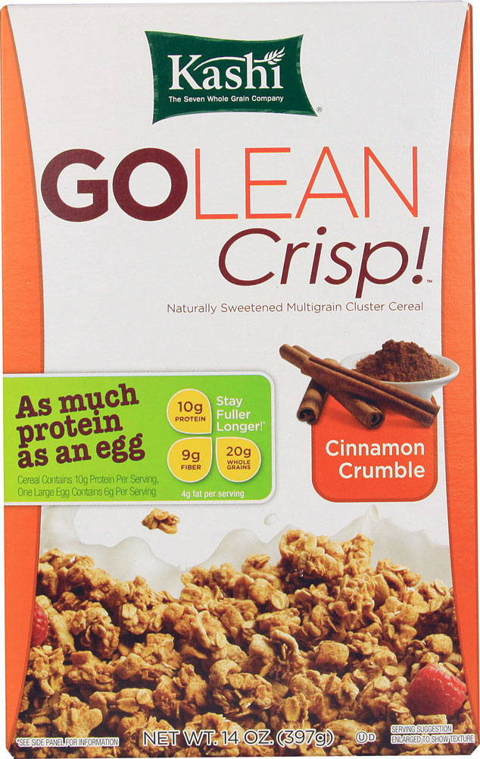
Kashi go lean crisp - cinnamon
Notes:
http://www.vitacost.com/Images/Products/1000/Kashi/Kashi-GoLean-Crisp-Cereal-Cinnamon-Crumble-018627703655.jpg

Slide 48
GMO-free

Slide 49
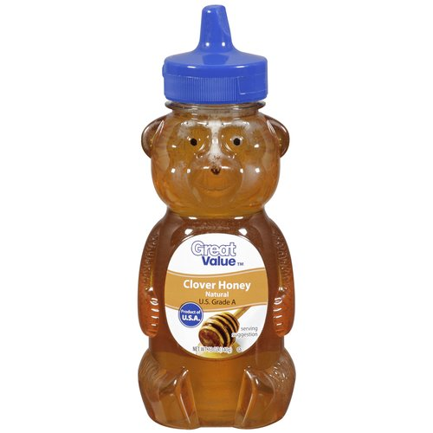
Great value brand Honey
Notes:
http://fitness.makeupandbeauty.com/wp-content/uploads/2013/06/honey-kills-bacteria1.jpg

Slide 50
Contains GMOs
Notes:
http://i.walmartimages.com/i/p/00/07/87/42/00/0007874200667_500X500.jpg

Slide 51
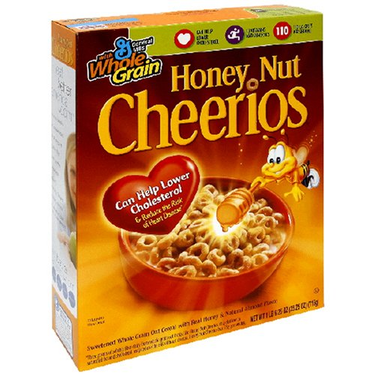
Honey Nut cheerios
Notes:
http://mojosavings.com/wp-content/uploads/2012/10/honey-nut-cheerios.jpg

Slide 52
Contains GMOs

